Slide 1
Transcriptome and isoform reconstruction with short reads
Johan Reimegård
SciLifeLab RNAseq workshop
March 2017

Slide 2
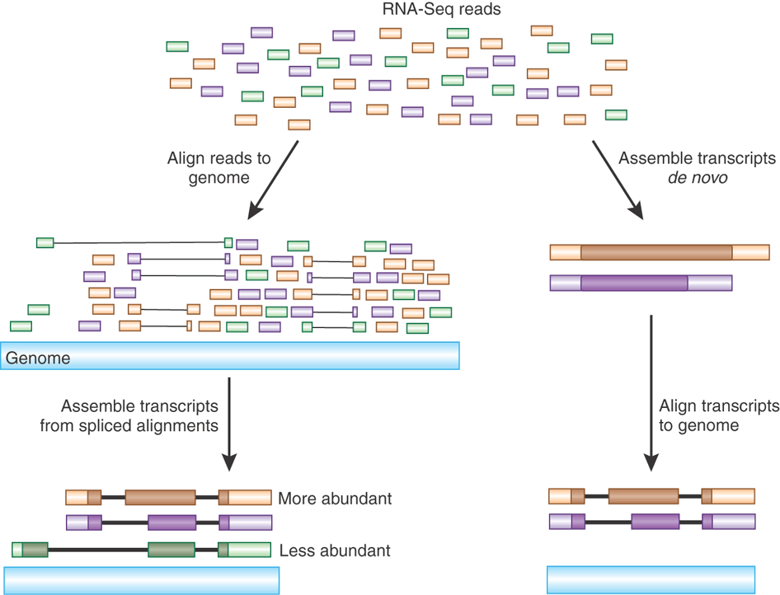
Transcriptome assembly
Haas and Zody, Nature Biotechnology 28, 421–423 (2010)

Slide 3
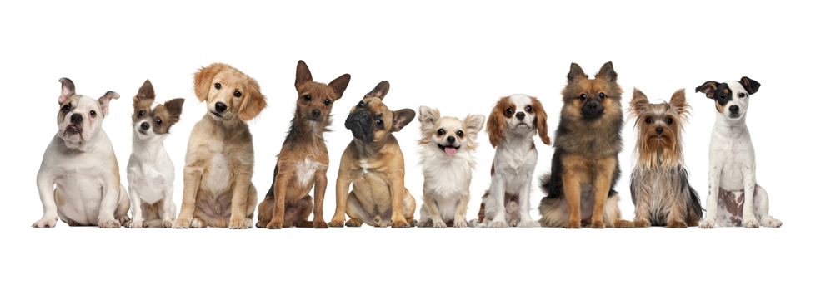
Reference-based assembly
Case study:
The transcriptome of the domestic dog
An improved canine genome and a comprehensive catalogue of coding genes and non-coding transcripts. Hoeppner MP et al. PLoS One 2014 Mar 13;9(3):e91172

Slide 4
Reference-based assembly
Why dogs?
Shared environment with humans for > 10.000 years
Affected by cancer or heart disease
Breed-specific disease
New genome release in 2011 (canFam3.1)
85 Mb of additional sequences integrated
99.8% of euchromatic portion of genome covered, high quality
Annotation: not so good
Mostly homology-based
Almost no isoform information

Slide 5
Reference-based assembly
10 tissues at great depth (30-100 million paired-end reads)
blood, brain, heart, kidney, liver, lung, ovary, skeletal muscle, skin, and testis
2 sets of libraries
strand-specific dUTP with poly-A selection: captures protein coding genes and other transcripts transcribed by polymerase II
duplex-specific nuclease (DSN): targets all RNAs, reduces the levels of the highly abundant ribosomal transcripts through normalization

Slide 6
Reference-based assembly
For each sample (tissue/library)
For each library (Poly-A, DSN)
Brain
Skin
Lung
…
Reads
merge
Mapper
Poly-A transcriptome
Filter q >15
Mapped reads
Final transcriptome
Poly-A transcriptome
DSN transcriptome
Assembler
Assembled transcripts
merge
Combined transcriptome

Slide 7
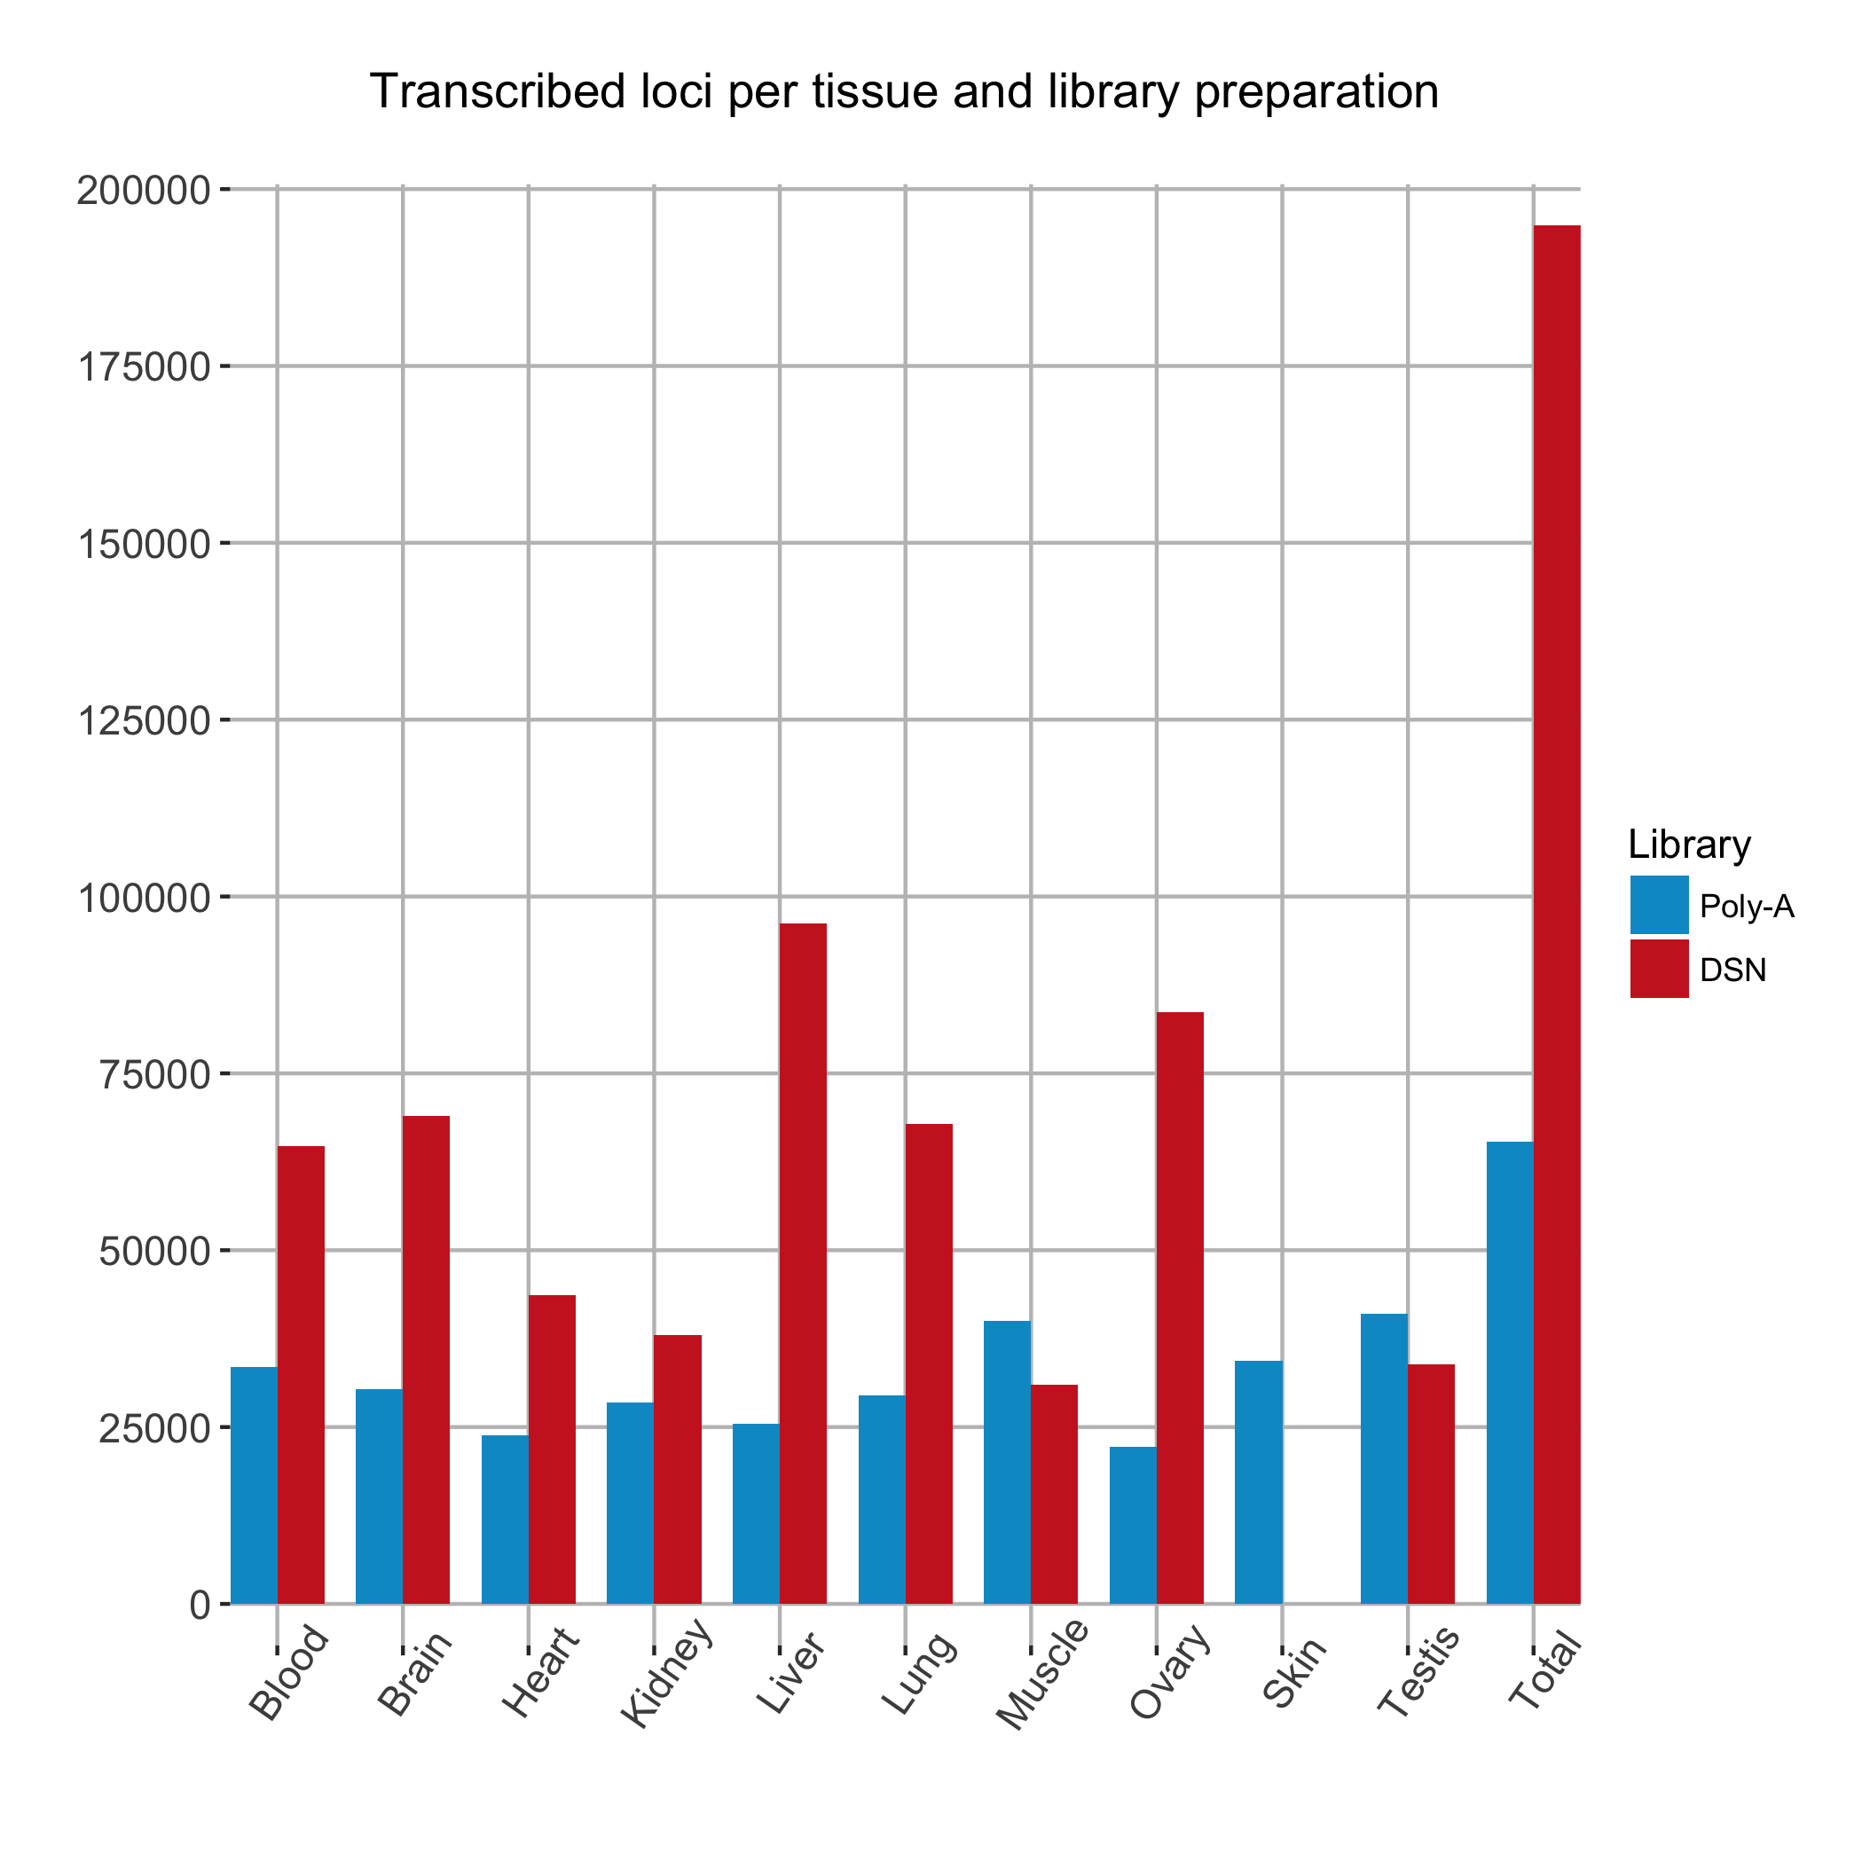
Reference-based assembly
DSN recovers more transcripts
Poly-A: highest number in testis, then muscle
Poly-A: heart and muscle share 88% of loci
Mean transcript length:
Poly-A: 3169 bp
DSN: 1485 bp

Slide 8
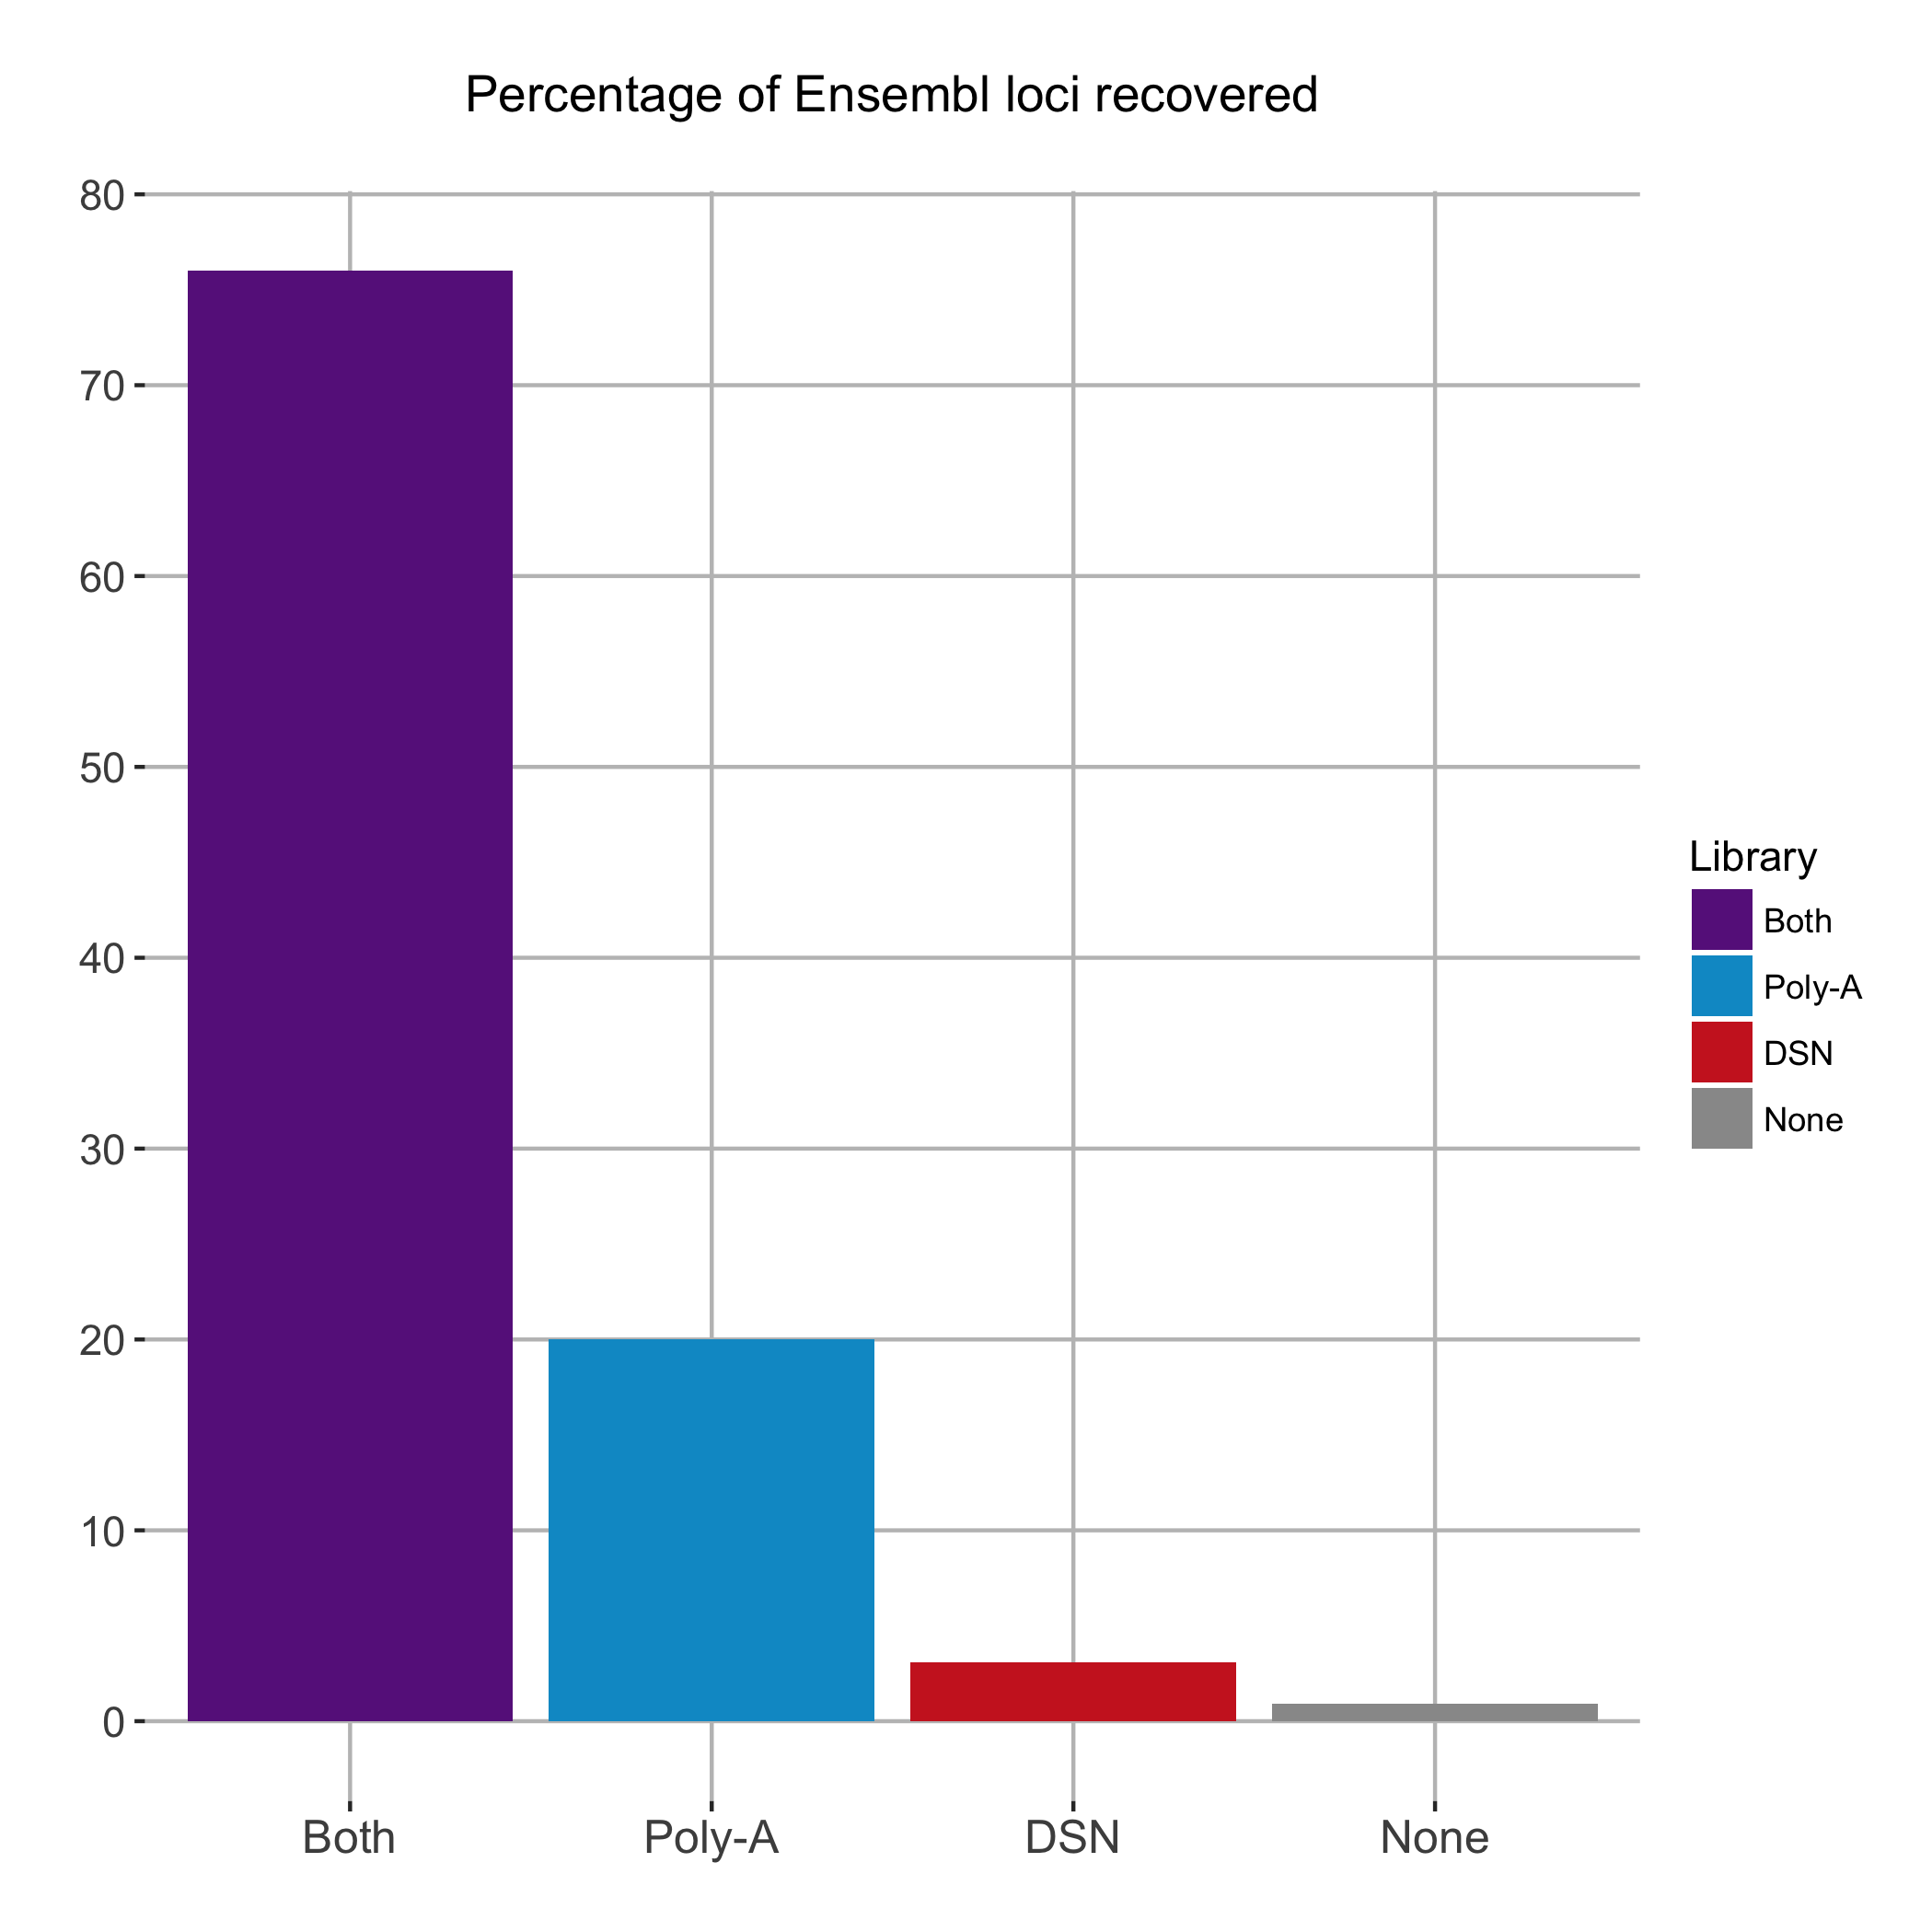
Reference-based assembly
Ensembl build 64: 19,856 annotated loci
Combined Poly-A + DSN: 174,336 loci
Majority located in introns of known genes and transcribed in the same sense
potential byproducts of incomplete splicing
Many located outside of known features, seem independently transcribed

Slide 9
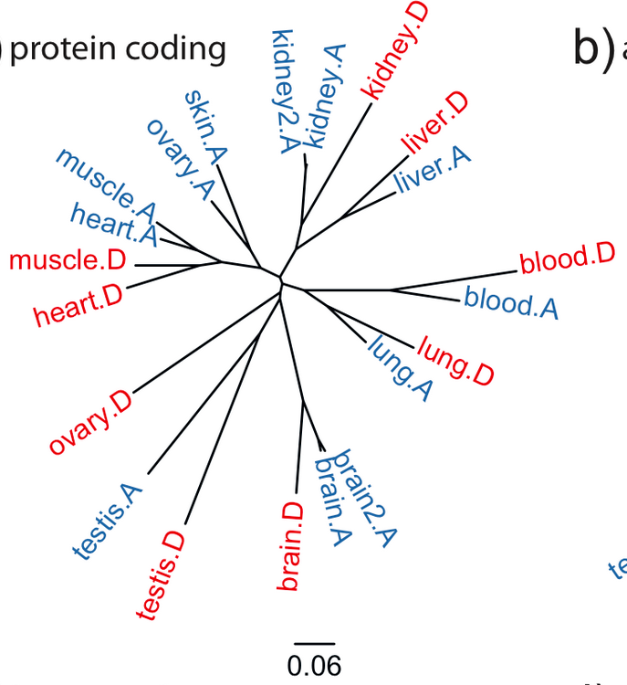
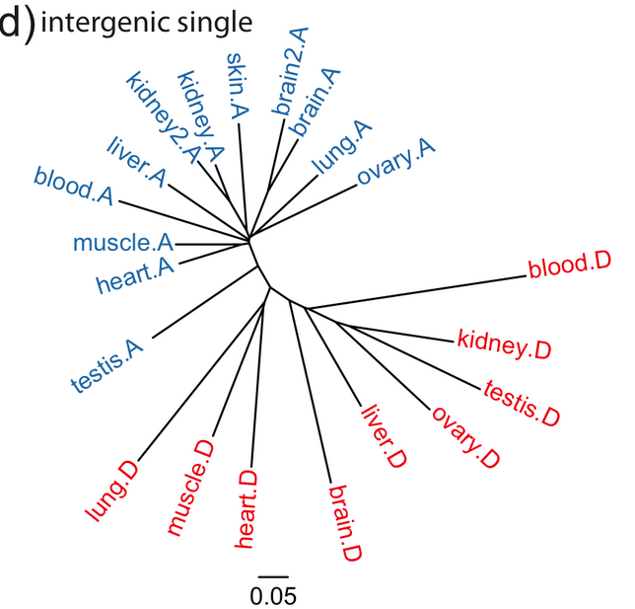
Reference-based assembly
Distance trees of expression profile
Neighbor-joining trees based on the correlation between expression values (FPKM>1.0) between samples
Protein-coding genes with RNA-Seq support
Intergenic and uncharacterized single exons
An improved canine genome and a comprehensive catalogue of coding genes and non-coding transcripts. Hoeppner MP et al. PLoS One 2014 Mar 13;9(3):e91172

Slide 10
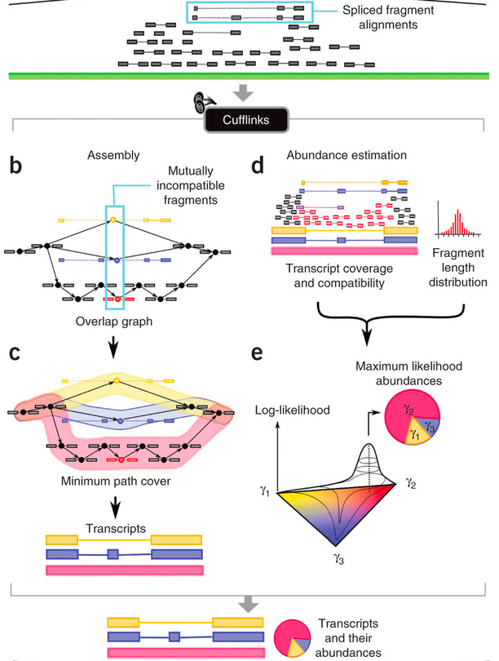
Reference-based assembly
Cufflinks
From the “Tuxedo” protocol
Transcript assembly and quantification by RNA-Seq reveals unannotated transcripts and isoform switching during cell differentiation. Trapnell C. et al. Nature Biotechnology 28, 511–515 (2010)

Slide 11
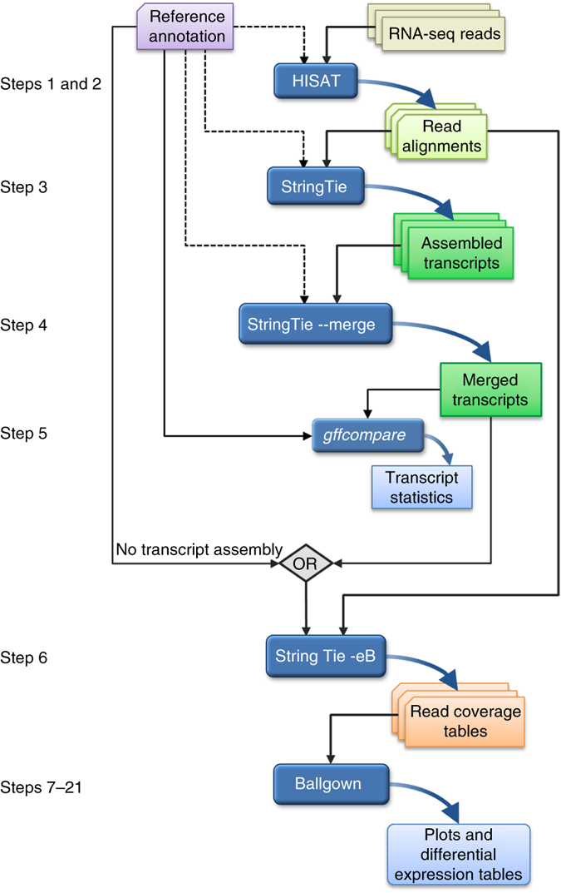
Reference-based assembly
The “new Tuxedo” protocol
Transcript-level expression analysis of RNA-seq experiments with HISAT, StringTie and Ballgown. Pertea M. et al. Nature protocol 11, 1650–1667 (2016)

Slide 12
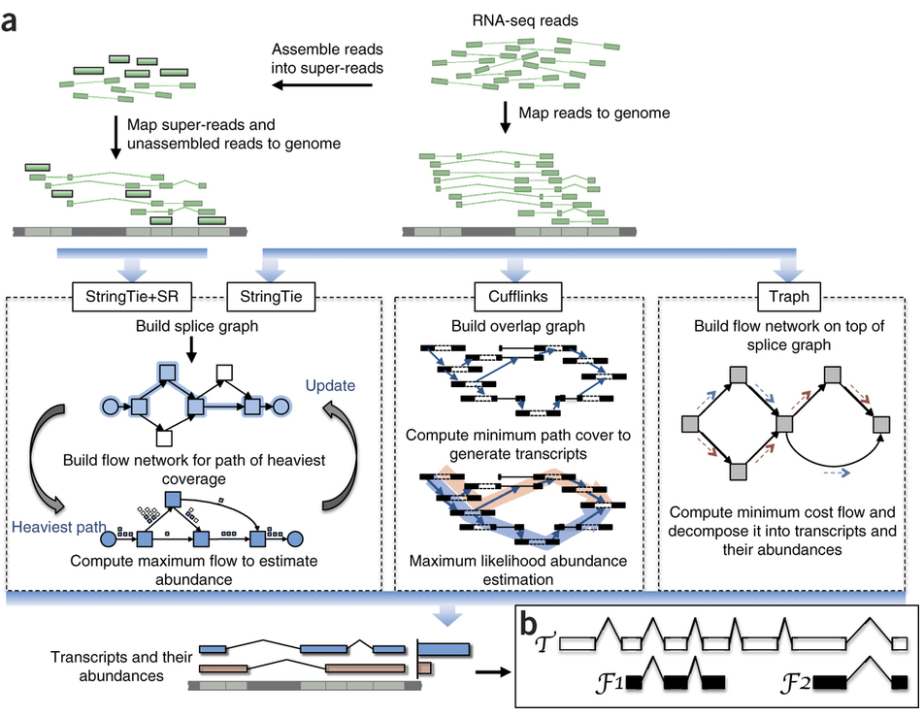
Reference-based assembly
StringTie
From the “new Tuxedo” protocol
StringTie enables improved reconstruction of a transcriptome from RNA-seq reads. Pertea M.. et al. Nature Biotechnology 33, 290–295 (2015)

Slide 13
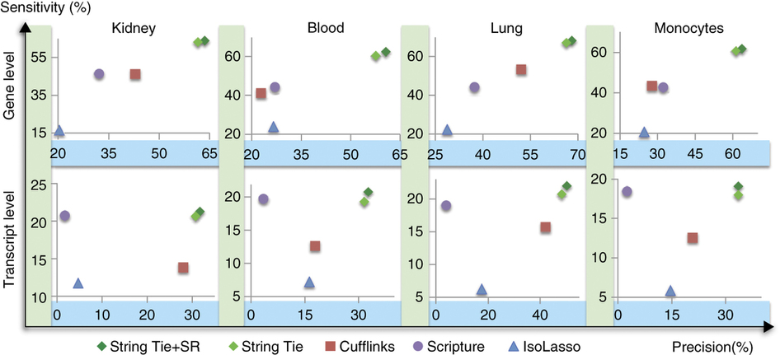
Reference-based assembly
StringTie
Fig.3: Accuracy of transcript assemblers at assembling known genes, measured on real data sets from four different tissues (RefSeq, UCSC or Ensembl human gene databases)
Sensitivity (genes): % of genes for which a program got at least one isoform correct
Sensitivity (transcripts): % of known transcripts that were correctly assembled
Precision: % of all predicted genes/transcripts that match an annotated gene/transcript

Slide 14

Reference-based assembly
Take-home message
Need a very good reference (genome most of the time)
Can use existing annotation (GTF/GFF file)
Can detect novel transcripts

Slide 15
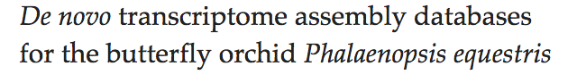
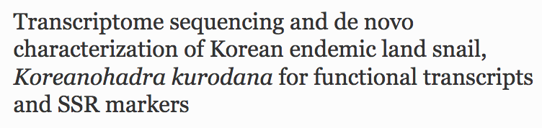
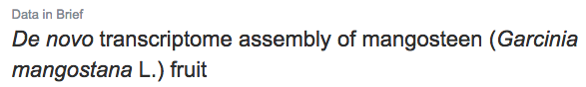
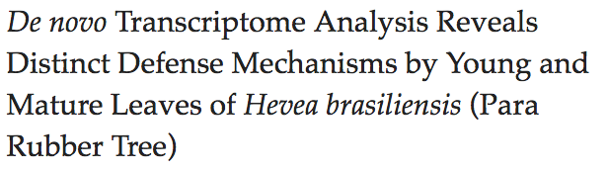
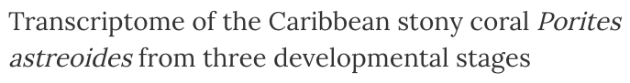
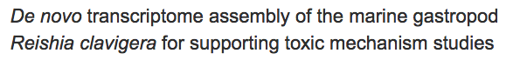
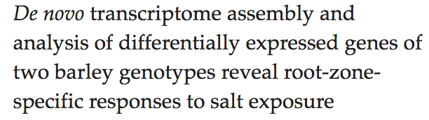
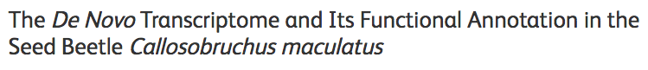


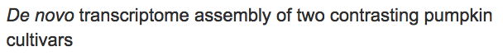
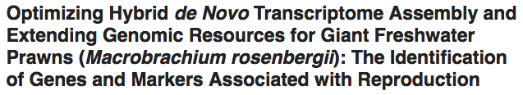
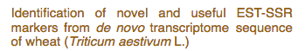
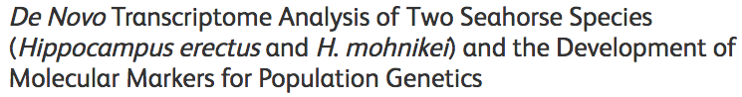
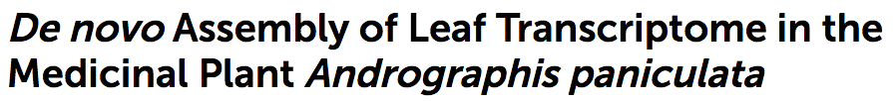
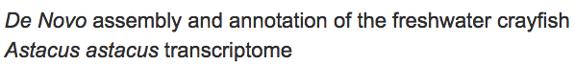
De novo assembly

Slide 16

De novo assembly
Most used programs (latest release date):
SOAPdenovo-Trans (July 2013)
Trans-ABySS (August 2016)
Velvet+Oases (March 2015)
Trinity (March 2016)
Originally SOAPdenovo, ABySS and Velvet for de novo genome assembly
“SOAPdenovo-Trans incorporates the error-removal model from Trinity and the robust heuristic graph traversal method from Oases.”
All based on de Bruijn graph

Slide 17
De novo assembly
The de Bruijn graph
CTTGGAACAATATGAATTGGCAAT ATTGGCAATTGACTTTTGCCGTAAT
CCGTAATCCGGCATATCTGGATA
Kmers (k = 7)
CTTGGAA
TTGGAAC
TGGAACA
GGAACAA
GAACAAT
…
ATTGGCA
TTGGCAA
TGGCAAT
ATTGGCA
TTGGCAA
TGGCAAT
GGCAATT
GCAATTG
…
GCCGTAA
CCGTAAT
CCGTAAT
CGTAATC
GTAATCC
TAATCCG
…
TCTGGAT
CTGGATA

Slide 18
De novo assembly
Kmers library
Graph
CTTGGAA
TTGGAAC
TGGAACA
GGAACAA
GAACAAT
…
ATTGGCA
TTGGCAA
TGGCAAT
GGCAATT
GCAATTG
…
GCCGTAA
CCGTAAT
CGTAATC
GTAATCC
TAATCCG
…
TCTGGAT
CTGGATA
CTTGGAA
TTGGAAC
TGGAACA
GGAACAA
GAACAAT
…
ATTGGCA
TTGGCAA
TGGCAAT
ATTGGCA
TTGGCAA
TGGCAAT
GGCAATT
GCAATTG
…
GCCGTAA
CCGTAAT
CCGTAAT
CGTAATC
GTAATCC
TAATCCG
…
TCTGGAT
CTGGATA

Slide 19
De novo assembly
Graphs can have nodes and edges
G GGCAATTGACTTTT
/ \ /
CTTGGAACAAT TGGAATT
\ / \
A GAAGGGAGTTCCAC

Slide 20
De novo assembly
Differences between programs:
Kmer length
Removing edges
G
/ \
CTTGGAACAAT TGGAATTGAAGGGAGTTCCAC
\ /
A

Slide 21
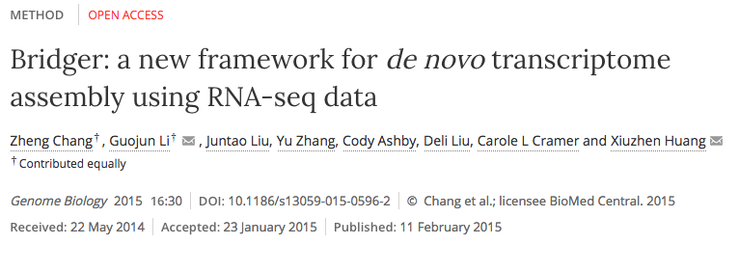
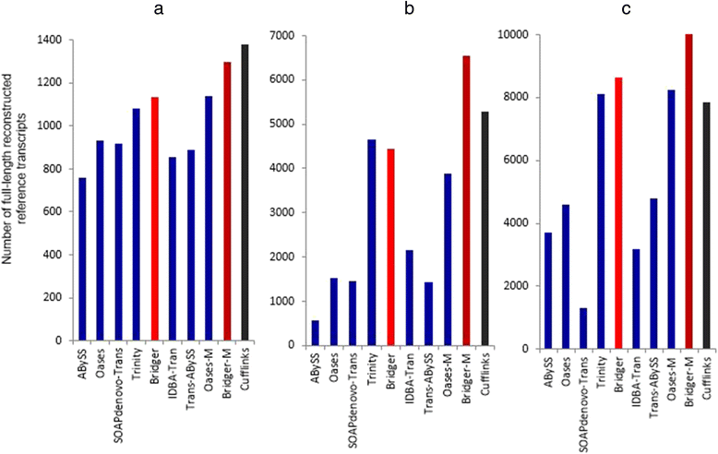
De novo assembly
Number of full-length reconstructed reference transcripts for (a) dog, (b) human, and (c) mouse

Slide 22
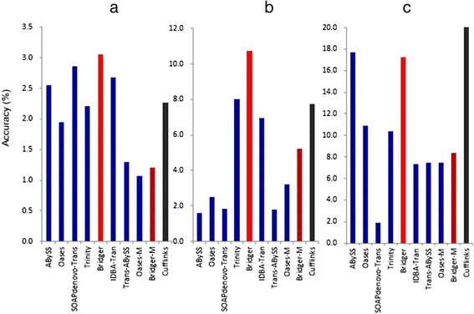
De novo assembly
Accuracy for (a) dog, (b) human, and (c) mouse [the most reference transcripts by the least candidate transcripts]

Slide 23
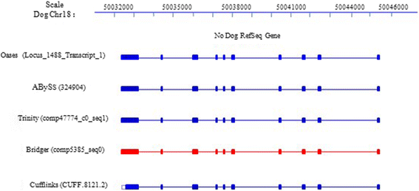
De novo assembly
A novel gene containing 10 exons was assembled by all assemblers. Interestingly, all de novo assemblers captured longer UTR than the reference-based assembler Cufflinks

Slide 24
De novo assembly
A novel gene containing 10 exons was assembled by all assemblers. Interestingly, all de novo assemblers captured longer UTR than the reference-based assembler Cufflinks

Slide 25
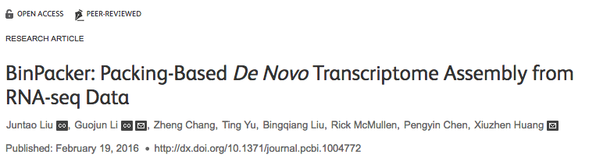
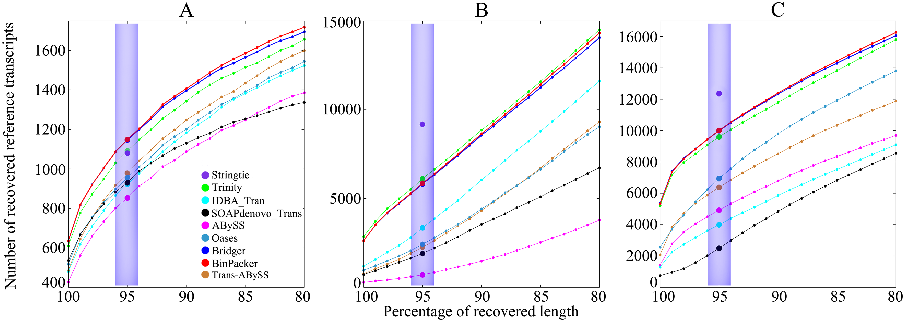
De novo assembly
Comparison of recovered reference sensitivity and its distribution against recovered sequence length rates (sequence identity) ranging from 80% to 100% on (A) dog, (B) human and (C) mouse datasets.

Slide 26
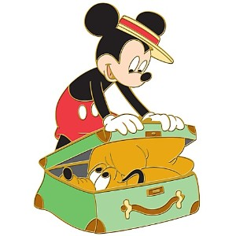
De novo assembly
Take-home message
No reference needed
Many programs available
Lots of potential transcripts. Filter!

Slide 27
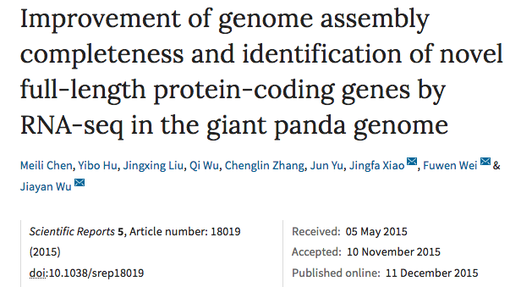

Combining both methods

Slide 28
Combining both methods
Background
1st de novo assembled genome based solely on short reads (Li et al., Nature 463, 2010)
23,408 genes annotated on the basis of a homology search with human and dog genes and ab initio methods
RNA-seq: 12 tissues
liver, stomach, small intestine, colon, pallium and testis from 1 male adult
pituitary gland, skeletal muscle, tongue, ovary and skin from 1 female adult

Slide 29
Combining both methods
Reference-based:
Transcripts reconstruction: Cufflinks (alignment: TopHat)
De novo:
Transcripts reconstruction: Trinity
24 assemblies (12 tissues * 2 methods)
Merge the 12 transcriptomes for each method
Merge the 2 method transcriptomes

Slide 30
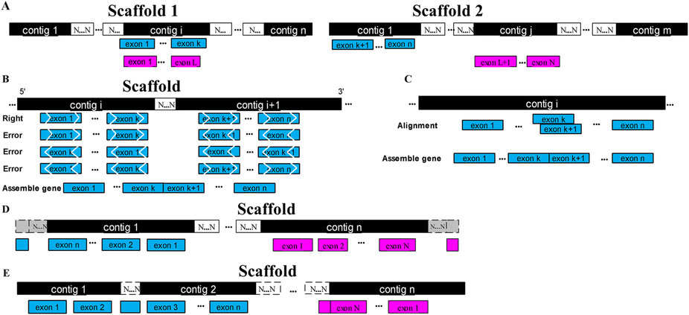
Combining both methods
Improvement of genome assembly
(A) Scaffolding improvement; (B) Scaffolding inconsistencies; (C) Nest assembly errors; (D) Boundary extensions; (E) Gap closure

Slide 31
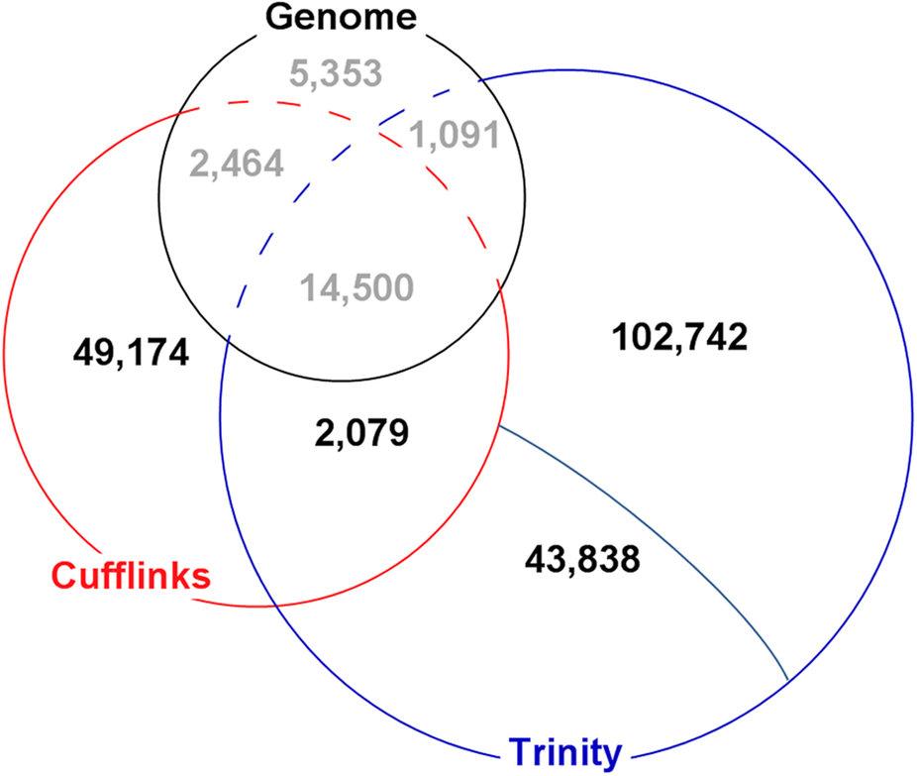
Combining both methods
Transcriptome reconstruction
Transcripts located to scaffolds that did not cover any known gene models
Transcripts unaligned back to the giant panda draft genome
49,174 + 2,079 + 43,838 + 102,742 = 197,833 potential novel transcripts!

Slide 32
Combining both methods
Validation of candidate novel protein-coding genes
ORF detection (Augustus)
197,833 novel transcripts => 28,522 potential novel protein-coding genes
Homology search (blast) – 3 categories
551 (1.93%) homology-based genes that were similar to known proteins in the nr database and known cDNA sequences in the nt database;
6,290 (22.03%) unknown genes that were similar to EST sequences in dbEST but had no protein or cDNA homology information;
12,575 (44.09%) hypothetical genes that had a complete ORF but no known homologs.
9,106 ORFs were filtered out (no start or stop codon, too short CDS…)

Slide 33
Combining both methods
Validation of candidate novel protein-coding genes
Protein domain search on 19,416 ORFs (InterProScan)
409 out of 551 homology-based genes
5,112 out of 6,290 unknown genes
7,981 out of 12,575 hypothetical genes
Proteomic analysis in 5 tissues
12,043 peptide hits
1,691 novel protein-coding genes characterized with at least 1 peptide

Slide 34

Combining both methods
Take-home message
Useful if the reference is incomplete
Can help improving the reference
Can help annotating the reference
Need to filter the results!

Slide 35

Thank you for listening!
Questions?

